Slide 1
Segmenting the smartwatch market
Group 2
Aastha Joshi 20020845001
Aishwarya Singh 20020845004
Harsh Tambe 20020845010
Joel Keith Pais 20020845011
Taksande Sandeep Ravindra 20020845030

Slide 2
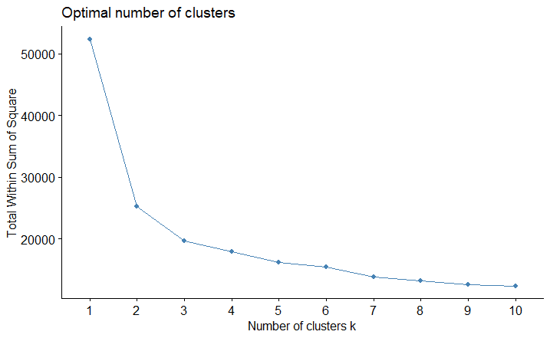
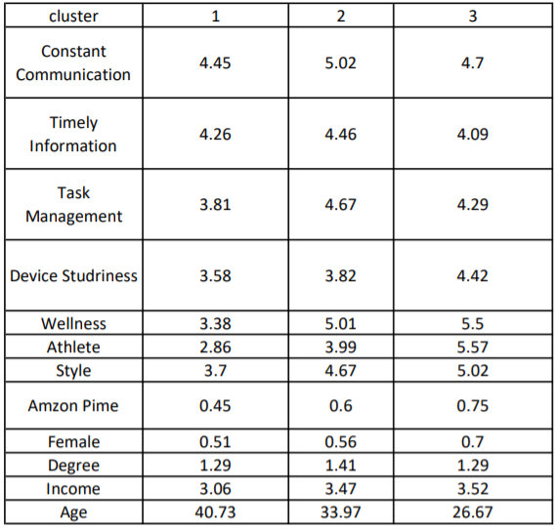
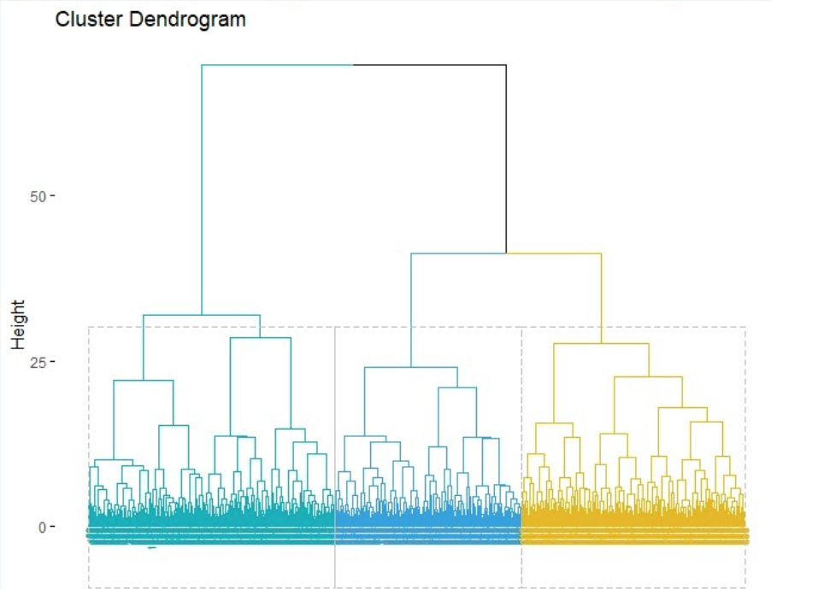
OUTPUT
QUESTIONS
A. Determine the number of distinct segments present in the market as represented in the current respondent sample.
Ans: In cluster analysis, the elbow curve method is a heuristic that is used to find the optimal number of clusters in a particular data set. In our data set, the number of clusters will be 3, as is evident from the dendrogram and by the elbow curve as well.
Elbow curve
Dendrogram
CSV output table

Slide 3
B. After determining the number of segments, describe each using the segmentation and descriptor variables:
Ans: The 3 clusters have been decided based on the variables in the csv files.
CLUSTER 1
The average age in this cluster is 40.73 which can be considered to be an upper age range, the Male: Female is 0.51 hence it has almost the same number of males and females. This cluster has the lowest income (3.06) among all the clusters. They have the lowest need for constraint Communication (4.45). They are least interested in Task Management (3.81), Device Sturdiness (3.58), Wellness (3.38), Athlete (2.26) and Style (3.7). Among all the clusters, they are least in having Amazon Prime Account (0.45).
CLUSTER 2
This cluster consists of consumers with average age of 33-34 years and have given highest preference to constant communication (5.02), timely information (4.46), task management (4.67) and well-being (5.01). This is the most educated cluster (1.41) with moderate disposable income (3.47). They want a durable, efficient and a budget-friendly smartwatch option with all the basic features.
CLUSTER 3
This cluster rate more than 5 on wellness (5.5), athlete(5.57) and style (5.02). This segment rates higher than the other two clusters on device sturdiness (4.42) as well. Also this segment contains more females (0.7) and a relatively younger population with an average age of just 26.76. Thus this segment can be seen as a young female-dominated cluster who like to be in line with the latest trends and style. And also belongs to the fitness cult.
C. Based on the characteristics create a name for each segment that captures the essence of what makes it unique
Ans: Cluster 1 - The middle-aged urbanite class
Cluster 2 - The erudite class
Cluster 3 - The young chic class

Slide 4
D. Rate the attractiveness of each smartwatch segment on a scale of 1-7. Explain the factors that went into your rating.
 | Cluster 1 | Cluster 2 | Cluster 3
Attractiveness Score(on a scale of 1-7) | 2 | 6 | 5
Factors | Not interested to pay a higher amount (price sensitive) Prefer subtle notifications Receive creative and fun communication | Have a moderate budget. Demand value for money product. Wellness and constant communication | Can go for luxurious products Not price sensitive Keep up with trend Forms a large segment for fitness oriented high end products.
E. Identify the segment(s) you believe is Intel’s best target
Ans: The combined clusters 2 and 3 represent 53.9% of the overall sample size. Moreover, the income level of these two clusters are more than that of 1. So we feel they can be enthusiastic in investing in smartwatches and can even go for a higher range product. These two clusters form a younger generation with an age range of 26-36. Hence, we feel that Intel should target these two clusters.

Slide 5
THANK YOU

